Slide 1
  Lesson4: Integration

Slide 2
Lesson 4: Integration
Integration tab contains following Sub Tabs
  Inbound Data
  Record Search
  Configuration
  Extract Reports
  Processing
  Workflow
  Tools
Notes:
Few important icons of Integration are:-
Inbound Data
Record Search
Configuration
Extract Reports
Processing
Workflow
Tools

Slide 3
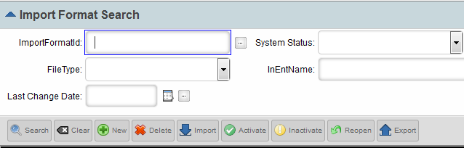
Lesson 4: Configuration – Import Format Search
Mainly helps to create the mapping to load data from source to staging tables.
Integration ->Configuration
Step 1:
New Mapping Creation
Notes:
Mainly helps to create the mapping to load data from source to staging tables.

Slide 4
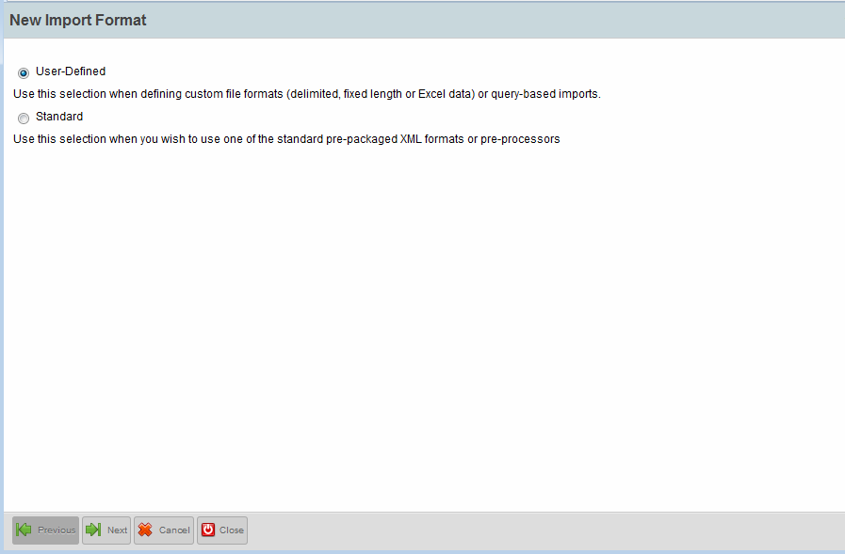
Lesson 4: Configuration – Import Format Search
Step 2:
Next
Notes:
Step 2:
Here, the radio button “User-Defined” is clicked, these can be changed as per requirement.

Slide 5
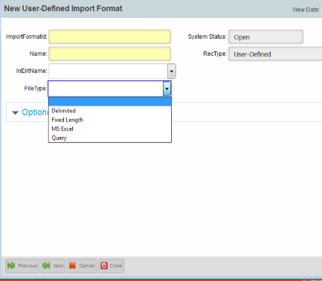
Lesson 4: Configuration – Import Format Search
Step 3: Fill in the mandatory fields.
Choose the InEntName for which the mapping needs to be created.
Choose the File Type.
Select From Drop Down
Notes:
Step 3: a) Fill in the mandatory fields.
b) Choose the InEntName for which the mapping needs to be created.
c) Choose the File Type.

Slide 6
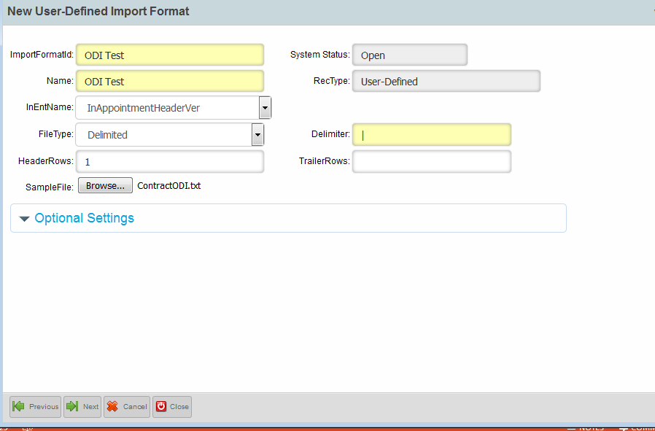
Lesson 4: Configuration – Import Format Search
Step 4: The values shown are sample values.
Next
Notes:
Step4: Need to fill in the fields as required.
FileType depends on business requirement and can be chosen from the dropdown list, the delimiter type needs to be mentioned.

Slide 7
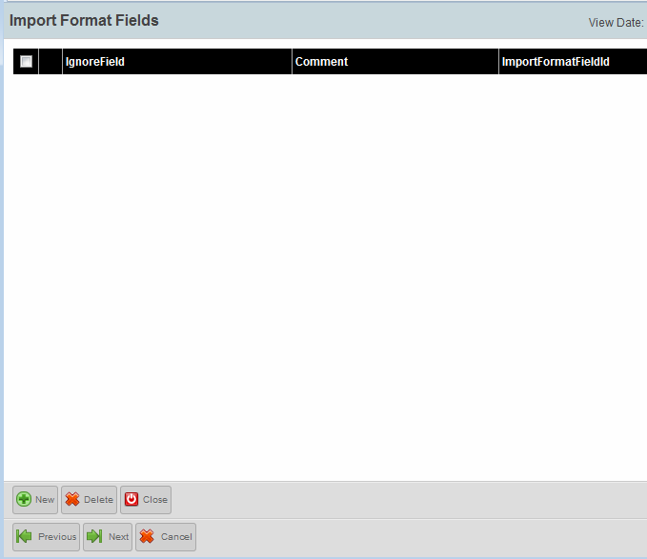
Lesson 4: Configuration – Import Format Search
Step 5:
Next

Slide 8
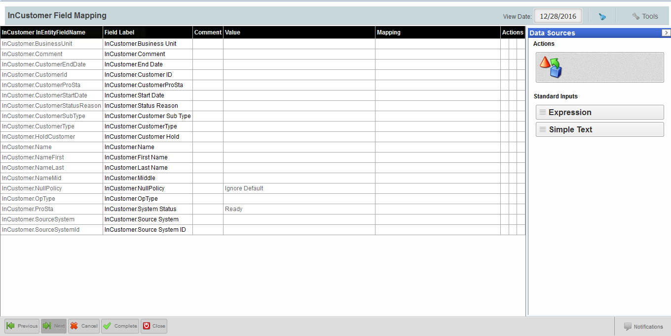
Lesson 4: Configuration – Import Format Search
Step 4:
Complete
Notes:
The left pane maps header from input file (which will be available in the right pane) in Standard Inputs. One needs to drag and drop the field from right to left, once done click on Complete.

Slide 9
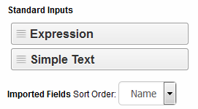
Lesson 4: Configuration – Import Format Search
Standard Inputs:
Expression – Business Rules can be configured here.
Simple Text – Hard-coded values.
Imported Fields:
Header from the source file, which are input for Direct mapping.
Notes:
Mapping can be mostly of 3 types viz. Direct mapping (source field mapped to target), Hardcoded value as simple text and business logic to be entered through Expression text. Usage of source field can be done in Expression text to handle complex logic or validations.

Slide 10
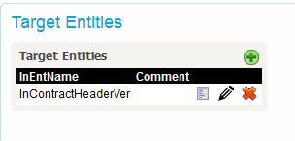
Lesson 4: Configuration – Import Format Search
To modify existing mapping:-
After creation/modification click on the “Activate” button.
Edit
Activate
Notes:
For modification of existing mapping, click on “Edit” button as shown, a new window appears, where one can modify as per requirement. Once completed click on “Activate” button.

Slide 11
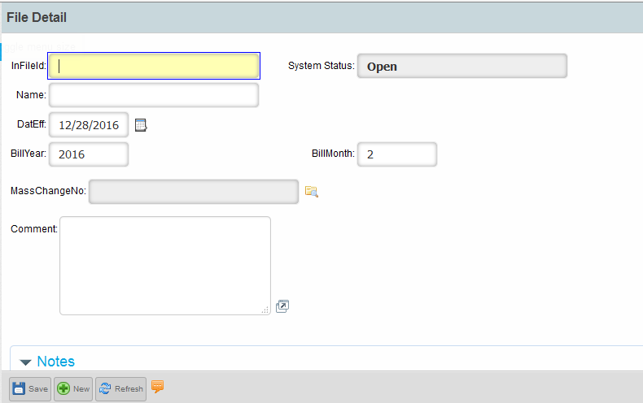
Lesson 4: Inbound Data
Steps to load data through ODI files into the Staging and PMPRO tables.
Step1:-
Enter an InFileId, Name can be the same.
Notes:
While loading ODI files we need to provide the data into the mandatory fields then click on “Save” button.

Slide 12
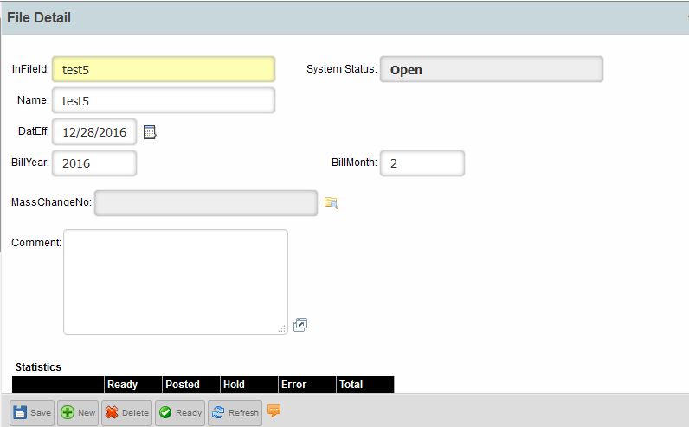
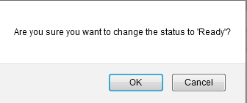
Lesson 4: Inbound Data
Step2:-
Ok
Ready
Notes:
After saving, the page appears as shown, click on the “Ready” button.

Slide 13
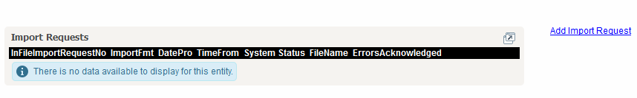
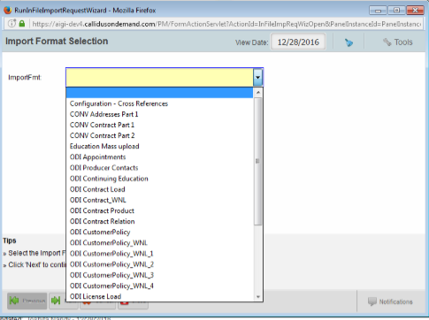
Lesson 4: Inbound Data
Step3:-
Step4:-
Click Here
Choose the mapping list
Notes:
Click on “Add Import Request” to add the file you need to upload, choose the format whose file is to be loaded.

Slide 14
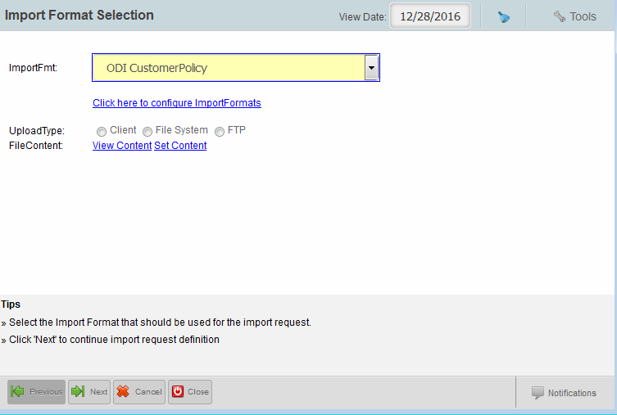
Lesson 4: Inbound Data
Step 5:-
Click Here
Click Here
Notes:
By clicking on “Set Content” it will ask you to upload the file.

Slide 15
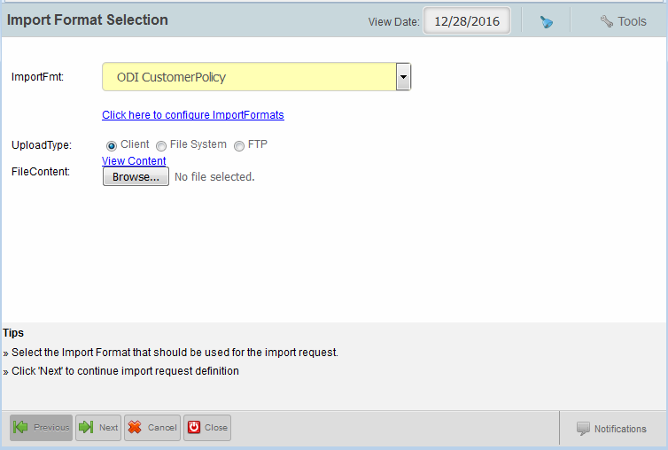
Lesson 4: Inbound Data
Step 6:-
Click to choose the file that you need to upload
Next
Notes:
The location can be browsed and file can be uploaded.

Slide 16
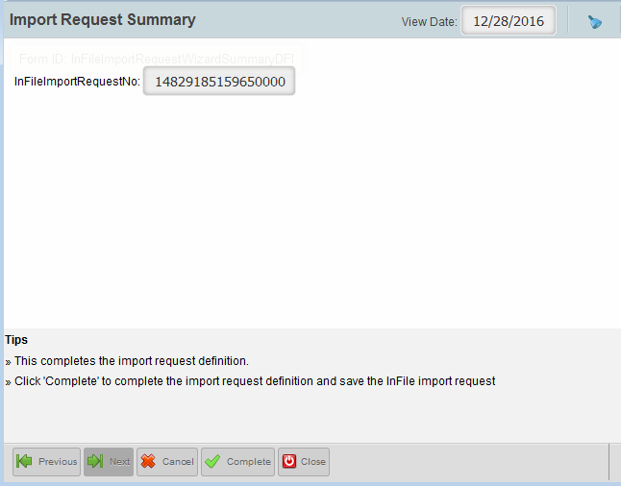
Lesson 4: Inbound Data
Step 7:-
Complete
Notes:
Complete button ends loading the file from local to server in a “Ready” mode.

Slide 17


Lesson 4: Inbound Data
Step 8:-
Statistics
Ready – Records from the file posted (except header) to Staging(IN) tables ready for target table posting.
Posted – Records successfully posted to Target tables from staging
Hold – Records on hold (i.e yet to post)
Error – Records failed to post to Target tables from staging.
Total – The number of records available.
Thumb Rule:
The basic statistics to remember:
Ready = Total
Ready = Total = Posted (for successful posting)
Total = Posted + Error (for successful + unsuccessful posting)
Post
Notes:
The file is now ready for Posting showing the statistics.

Slide 18
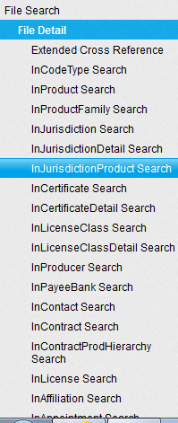
Lesson 4: Inbound Data
Few In-Tables

Slide 19
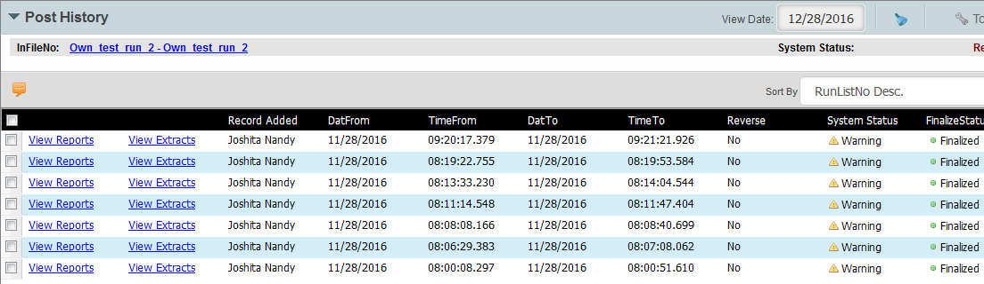
Lesson 4: Inbound Data - Debug
For any discrepancy or Post error, please refer “Post History”
Inbound Data -> Post History
Notes:
For any unsuccessful load or if there are result mismatch after posting, need to check for any warnings against the InFileId loaded.

Slide 20
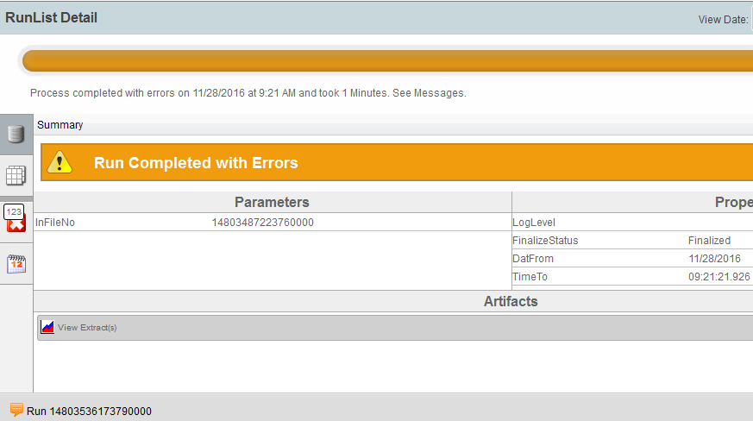
Lesson 4: Inbound Data - Debug
Inbound Data -> Post History->Warning
Notes:
Click on the arrow shown for expansion of errors.

Slide 21
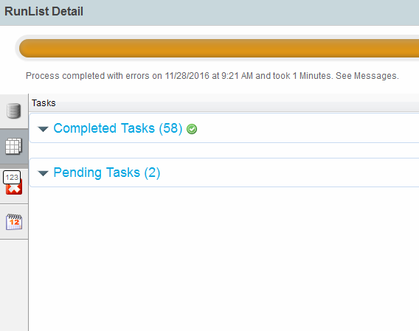
Lesson 4: Inbound Data - Debug
Clicking on “Completed Tasks” will help to locate the error (if any).
Expand the list
Notes:
The “Completed Tasks” will show you all the background activities related to file loading along with errors.

Slide 22
Test Your Understanding
  What are the various file type that can be handled?

Slide 23
Test Your Understanding
  Mapping can be defined as:

Slide 24
Test Your Understanding
  Can a file be Posted before moving it to Ready state?

Slide 25

Summary
You should now be able to:
  Creation/modification of ODI mapping.
  How to load an ODI.
  Locate the error while loading and debug.
Notes:
You should now be able to create/modify ODI mapping, load an ODI along with debug errors(if any) during load process.

